Slide 1
Family Town Hall
Learn the Way.Love the People.Live the Culture.
November 14, 2022
Serving Children First

Slide 2
School-Wide Norms for Parents and Families
Be courteous when communicating and always assume positive intention.
Recognize the value of instructional time and activities during the school day.
Demonstrate respect for the learning environment and school property.
Promote the dignity and self worth of others.
Demonstrate respect for the rights, property and feelings of others.
Avoid confrontations, profanity, and aggressive behavior.

Slide 3
Mission and Vision
Mission: To accelerate the opportunities and outcomes for our children by demanding nothing but excellence from the students, staff, and the community.
Vision: To accelerate the academic achievement of all students, in partnership with the entire community, to ensure that students have the attitudes, skills, and proficiencies needed to succeed in college and the 21st century global workforce.

Slide 4
School-wide Goals
Academic Achievement
Increase reading proficiency for students in all grades from 23% to 28% as measured by the end of the year State Assessment
Increase math proficiency for students in all grades from 15% to 20% as measured by the end of the year State Assessment.
Climate:
Ensure a safe and secure learning environment by decreasing office referrals from 249 to 200.
Ensure a safe and secure learning environment by decreasing school suspensions from 29 to 25.
Attendance:
Increase the yearly attendance rate from 93% to 94%.
Decrease chronically absent student rate from 43% to 20%.
Parental Engagement:
Increase parental participation in school programs to 45 or more parents per event and 2,500 volunteer hours as measured by sign in sheets and volunteer logs.

Slide 5
Furman L. Templeton’s Beliefs
All children can learn at high levels, regardless of their race, socioeconomic background, language, or family situation.
For children from a diverse spectrum to learn at high levels, they need to be taught by people in schools who believe they can learn, who approach teaching with the idea that students will learn if taught well, and who take seriously an ongoing effort to improve their practice in line with the best thinking and examples in the field.
For teaching of this kind to be realized across the whole school, leadership at the school needs to be squarely focused on supporting the improvement of teaching in an ongoing and routine way.

Slide 6
Objectives
By the end of this meeting participants will:
Receive schoolwide data and strategies
Know upcoming school-wide events and dates
Ask questions or share concerns

Slide 7
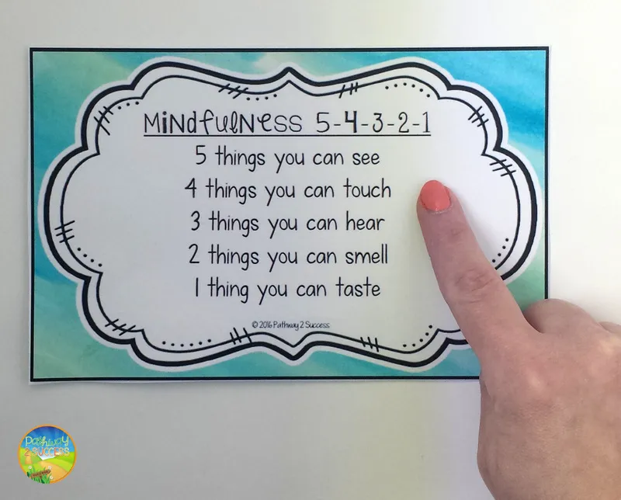
Mindful Moment

Slide 8

Parent Involvement and Engagement
Goal:
Increase parental participation in school programs to 45 or more parents per event and 2,500 volunteer hours as measured by sign in sheets and volunteer logs.

Slide 9

Parent Ambassadors Update

Slide 10
Attendance Data
School-Wide Goal: To increase the yearly attendance rate from 88% to 94%.
Grade | Goal | Aug | Sept | Oct | Nov | Dec | Jan | Feb | Mar | Apr | May | Jun
Pre-K | 94% | 85.65% | 88.59%
K | 94% | 88.68% | 88.61%
1st | 94% | 88.15% | 87.76%
2nd | 94% | 85.64% | 88.65%
3rd | 94% | 86.47% | 89.62%
4th | 94% | 84.24% | 87.48%
5th | 94% | 79.88% | 86.86%
Total | 94% | 85.48% | 88.59%

Slide 11
Climate and Culture Data- Referrals
School-Wide Goal: To decrease office referrals from 249 to 200 by 6/2023.
Grade | Aug | Sept | Oct | Nov | Dec | Jan | Feb | Mar | Apr | May | Jun
Pre-K | 18 | 2
K | 0 | 1
1st | 6 | 3
2nd | 5 | 3
3rd | 4 | 4
4th | 8 | 0
5th | 4 | 11
Total | 45 | 24

Slide 12
Climate and Culture Data-Suspensions
School-Wide Goal: To decrease office suspensions from 249 to 200 by 6/2023.
Grade | Aug | Sept | Oct | Nov | Dec | Jan | Feb | Mar | Apr | May | Jun
Pre-K | 0 | 0
K | 0 | 0
1st | 0 | 0
2nd | 0 | 0
3rd | 0 | 2
4th | 2 | 4
5th | 1 | 3
SPED | 3 | 2
Total | 6 | 9

Slide 13
Amplify Reading Achievement Data
School-Wide Goal: Increase reading proficiency for students in all grades from 23% to 28% as measured by the end of the year State Assessment.
Amplify Reading Assessment 1
Grade | Total | Goal | Proficient | Approaching | Below
K | 54 | 28% | 39% | 14% | 47%
1 | 55 | 28% | 17% | 8% | 75%
2 | 64 | 28% | 21% | 11% | 68%
3 | 68 | 28% | 26% | 9% | 65%
4 | 54 | 28% | 22% | 11% | 67%
5 | 58 | 28% | 21% | 15% | 64%
SWD | 59 | 28% | 5% | 5% | 90%

Slide 14
ANET Reading Achievement Data
School-Wide Goal: Increase reading proficiency for students in all grades from 23% to 28% as measured by the end of the year State Assessment.
ANET Reading Assessment 1
Grade | Total | Goal | Proficient | Approaching | Below
2 | 64 | 28% | 0% | 10% | 84%
3 | 68 | 28% | 6% | 1% | 88%
4 | 54 | 28% | 1% | 11% | 72%
5 | 58 | 28% | 2% | 5% | 88%

Slide 15
Amplify Math Achievement Data
School-Wide Goal: Increase math proficiency for students in all grades from 15% to 20% as measured by the end of the year State Assessment.
Amplify Math Assessment 1
Grade | Total | Goal | Proficient | Approaching | Below
K | 54 | 20% | 5% | 47% | 48%
1 | 55 | 20% | 2% | 60% | 38%

Slide 16
ANET Math Achievement Data
School-Wide Goal: Increase math proficiency for students in all grades from 15% to 20% as measured by the end of the year State Assessment.
ANET Math Assessment 1
 | Total | Goal | Proficient | Approaching | Below
2 | 64 | 20% | 6% | 17% | 67%
3 | 68 | 20% | 1% | 5% | 61%
4 | 54 | 20% | 0% | 1% | 87%
5 | 58 | 20% | 0% | 7% | 81%
SWD |  | 20% | 0% | 0% | 100%

Slide 17
Schoolwide Goals and Strategies
Attendance
  continue implementing current schoolwide strategies
Climate
  continue tracking PBIS points
  make one positive point of contact with each student’s family
  create an opportunity for students to showcase a talent or interest during class
Achievement
  Reading
    improve application of decoding skills
    teach students how to ask and answer questions about vocabulary and key details of a text during discussion and writing
  Math
    Notice and Wonder
    RDW
    Increasing mathematical rigor during lessons

Slide 18
At-Home Strategies and Supports
Families can best support their scholar’s in reaching school goals by:
ensure students attend school daily and on-time
share expectations for students daily that include doing their best and learning something new
ensure students listen and follow the directions of the classroom teacher and school staff
be aware of student performance and progress towards learning goals

Slide 19
Grading and Report Cards
All instructional teachers are responsible to maintain grades. It is required that instructional teachers utilize Infinite Campus for report cards. At minimum, all students should receive one-two participation grades (homework) a week, one-two classwork grades a week, and one formative assessment grade a week and at least one summative grade a quarter in all core content areas. The following weight will be applied to student’s overall grade for a specific subject:
❑ Class work 20%
❑ Participation 10%
❑ Assessments 70%
Formative 50%
Summative 20%

Slide 20
Grading and Report Cards
The following grading scale will be used for grades Pre-K, Kindergarten, and Grade 1:
• 100% to 80%: Proficient (P)
• 79% to 60%: In Development (I)
• 59% or below: Needs Improvement (N)
The following grading scale will be used for grades 2-5:
• 90% or higher: Excellent (E)
• 80% to 89%: Good (G)
• 70% to 79%: Satisfactory (S)
• 60% to 69%: Poor (P)
• 59% or below: Unsatisfactory (U)

Slide 21
District Level Updates- Middle School Choice
3rd grade:
Join after-school clubs so you’ll have lots of different experiences and can find out what you like best
Think about your talents and what interests you most
Visit middle and high school websites
Talk to friends, neighbors, and family members about where they go to school
Find out about special programs like TWIGS, Ingenuity Project, Gateway to Technology, and gifted and advanced learning, and what’s required for each one
4th grade:
Talk with the choice liaison at your school about options for middle grades
Think more about your interests and talents and what kind of school would work best for you
Go to open houses at different types of schools, so you can see the range of options available
Stay focused on doing well, so you’ll meet requirements for special programs
Notes:
Name both focus strategies to help students reach reading and math goals.

Slide 22
District Level Updates- Middle School Choice
5th grade:
Narrow down your choices by visiting schools you’re interested in, going to the school choice fair, and talking to current students, parents, and staff members
Stay focused on doing well, so you’ll meet requirements for special programs
For the Ingenuity Project, register for the test; for charter schools, make sure you know the application deadlines
Meet with your choice liaison to get your questions answered and for help with your choice application
Notes:
Name both focus strategies to help students reach reading and math goals.

Slide 23
Upcoming School-Wide Events
Notes:
Follow the directions to practice fluency support at home.

Slide 24
Parent Voice
Notes:
Remind parents of upcoming dates.

Slide 25

Closing and Evaluation
Notes:
Families will complete the evaluation form

